Slide 1
Curriculum Conversations
LEAP Conference
Jake Sandison
Loyalist College

Slide 2
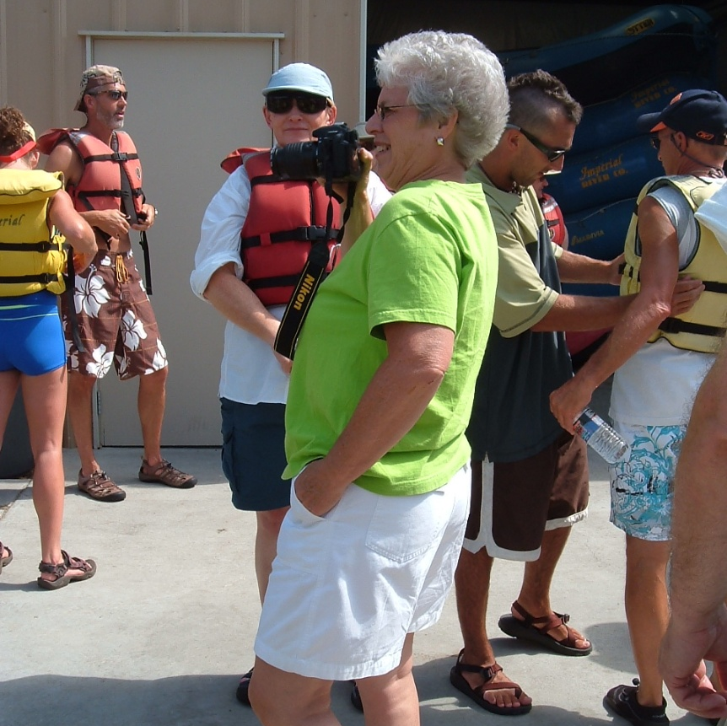
“Curriculum is a conversation, not a technology”
(Stiehl 2007)

Slide 3
Workshop Outcomes
Explore the role of the coordinator with respect to curriculum
Identify essential concepts and barriers involved in the fulfillment of the coordinators curriculum role(s)
Explore solutions for curriculum issues

Slide 4
Question 1: Coordinator’s Role
How would you define your coordinator role as it relates to curriculum?

Slide 5
Coordinator’s Role
The lead voice of curriculum for your program team
The lead “steward” of the curriculum

Slide 6
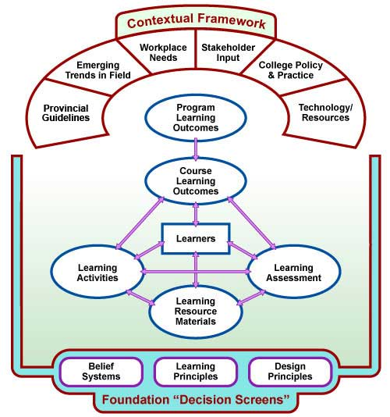
A Curriculum Framework…
Design down, deliver up
Learner is in the centre!
Outcomes rule…content is last to consider
Alignment!

Slide 7
Curriculum Questions and Approaches
Ideally done as a program team and in person
How do we engage PT faculty? What if curriculum renewal is occurring in May/June?
A map (several maps) are key and critical to guiding curriculum

Slide 8
Question 2: Interests/Challenges
What is your specific interest/strength related to curriculum?
What is the most significant curriculum issue you/your program is facing?

Slide 9
“Complex” Situations…
Course Ownership
One Full-time… many Part-time
Historical Practice
Demographics of program team

Slide 10
Facilitating Change
Transtheoretical Model of Change
Pre-contemplation
Contemplation
Preparation
Action
Maintenance

Slide 11
Other resources:
Stiehl, R. & Lewchuk.
Outcomes Primer
Assessment Primer
Mapping Primer
Aligning and Building Curriculum Resource Site

Slide 12
So What
What will you take away…
What conversation will you begin…
What strategy will you implement
from this session?

Slide 13
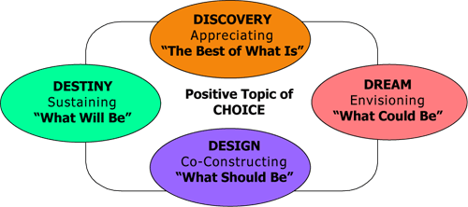
Appreciative Inquiry

Slide 14
Highly Reliable Organizations – Blame Free Culture
A constant concern about the possibility of failure
Deference to expertise regardless of rank or status
Ability to adapt when the unexpected occurs
Ability to concentrate on a task while having a sense of the big picture
Ability to alter and flatten the hierarchy to fit a specific situation

